Slide 1

CHA 2555
Artificial Intelligence
Clustering – Part 2
Dr Tianhua Chen
Department of Computer Science
University of Huddersfield
sadfsdf
Edited by Emmanuel Papadakis

Slide 2
Clustering lectures overview
Datasets, data points, dimensionality, distance
What is clustering?
Partitional clustering
  k-means algorithm
Hierarchical clustering
  Agglomerative/Divisive
  Single-link, complete-link, average-link
Tianhua Chen(T.Chen@hud.ac.uk)::CHA2555 Artificial Intelligence::Lecture 21::Clustering 2

Slide 3
Hierarchical clustering algorithms
Agglomerative (bottom-up):
  Start with each data point being a single cluster
  Merge based on closeness
  Eventually all data points belong to the same cluster
Divisive (top-down):
  Start with all data points belonging to the same cluster
  Split up based on distance
  Eventually each node forms a cluster on its own
Good: Does not require the number of clusters k in advance
Not-so-good: Needs a termination/readout condition
Tianhua Chen(T.Chen@hud.ac.uk)::CHA2555 Artificial Intelligence::Lecture 21::Clustering 2

Slide 4
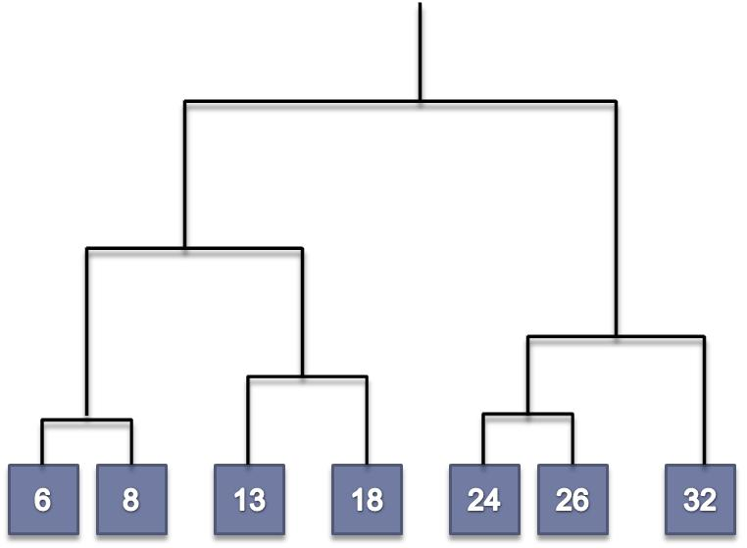
Hierarchical Agglomerative Clustering
Assumes a similarity function for determining the similarity of two data points
  = distance function in a n-dimensional space
Starts with all points in separate clusters
  Then repeatedly joins the clusters that are most similar until there is only one cluster
The history of merging forms a binary tree or hierarchy
Tianhua Chen(T.Chen@hud.ac.uk)::CHA2555 Artificial Intelligence::Lecture 21::Clustering 2

Slide 5
Hierarchical Agglomerative Clustering
Clustering obtained by cutting the dendrogram at a desired level: each connected component forms a cluster
Tianhua Chen(T.Chen@hud.ac.uk)::CHA2555 Artificial Intelligence::Lecture 21::Clustering 2

Slide 6
Hierarchical Agglomerative Clustering
Basic algorithm is straightforward
  Compute the distance matrix (= distance between any 2 data points)
  Let each data point be a cluster
  Repeat
    Merge the two (or more) closest clusters
    Update the distance matrix
  Until only a single cluster remains
Key operation is the computation of the proximity of two clusters
  Different approaches to defining the distance between clusters distinguish the different algorithms
Tianhua Chen(T.Chen@hud.ac.uk)::CHA2555 Artificial Intelligence::Lecture 21::Clustering 2
Notes:
Previously, we calculated the distance between the data points and the centroids; now we’re calculating the distance between each pair of data points.

Slide 7
Hierarchical clustering
Two important questions:
  How do you determine the “nearness” of clusters?
  How do you represent a cluster of more than one point?
Tianhua Chen(T.Chen@hud.ac.uk)::CHA2555 Artificial Intelligence::Lecture 21::Clustering 2

Slide 8
Example
cluster
cluster
1
2
4
6
5
3
intercluster
distance
Tianhua Chen(T.Chen@hud.ac.uk)::CHA2555 Artificial Intelligence::Lecture 21::Clustering 2
Notes:
How can the distance between clusters be computed?

Slide 9
Closest pair of clusters
Many variants to defining closest pair of clusters
Single-link
  Distance of the “closest” points
Complete-link
  Distance of the “furthest” points
Centroid
  Distance of the centroids (centers of gravity)
Average-link
  Average distance between pairs of elements
Tianhua Chen(T.Chen@hud.ac.uk)::CHA2555 Artificial Intelligence::Lecture 21::Clustering 2
Notes:
Closest point
Possible meanings:
Smallest maximum distance to the other points
Smallest average distance to other points
Smallest sum of squares of distances to other points
Etc...

Slide 10
Examples
Single-link
Complete-link
Average-link
Tianhua Chen(T.Chen@hud.ac.uk)::CHA2555 Artificial Intelligence::Lecture 21::Clustering 2

Slide 11
Single-link agglomerative clustering
Use minimum distance of pairs of data points:
Can result in “straggly” (long and thin) clusters due to a chaining effect
After merging c_{i} and c_{j}, the similarity of the resulting cluster to another cluster, c_{k}, is:
Tianhua Chen(T.Chen@hud.ac.uk)::CHA2555 Artificial Intelligence::Lecture 21::Clustering 2

Slide 12
Single-link example
1-dimensional data: {1,3,8,9,10}
  Current clustering is {1,3} and {8,9,10}
What is the single-link distance between these two clusters??
Distance is 5
  The difference between 3 and 8
  = two closest points across the clusters
Tianhua Chen(T.Chen@hud.ac.uk)::CHA2555 Artificial Intelligence::Lecture 21::Clustering 2

Slide 13
Exercise
Given the following 1D data: {6, 8, 18, 26, 13, 32, 24}, perform single-link HAC
  Compute the distance matrix (= distance between any 2 points)
  Let each data point be a cluster
  Repeat
    Merge the two (or more) closest clusters
    Update the distance matrix
  Until only a single cluster remains
Tianhua Chen(T.Chen@hud.ac.uk)::CHA2555 Artificial Intelligence::Lecture 21::Clustering 2

Slide 14
Distance matrix
 | 6 | 8 | 18 | 26 | 13 | 32 | 24
6 | 0
8 | 2 | 0
18 | 12 | 10 | 0
26 | 20 | 16 | 8 | 0
13 | 7 | 5 | 5 | 13 | 0
32 | 26 | 24 | 14 | 5 | 19 | 0
24 | 18 | 16 | 6 | 2 | 11 | 8 | 0
  Let each data point be a cluster
  Repeat
    Merge the two (or more) closest clusters
    Update the distance matrix
  Until only a single cluster remains
Tianhua Chen(T.Chen@hud.ac.uk)::CHA2555 Artificial Intelligence::Lecture 21::Clustering 2

Slide 15
Distance matrix
 | 6 | 8 | 18 | 26 | 13 | 32 | 24
6 | 0
8 | 2 | 0
18 | 12 | 10 | 0
26 | 20 | 16 | 8 | 0
13 | 7 | 5 | 5 | 13 | 0
32 | 26 | 24 | 14 | 5 | 19 | 0
24 | 18 | 16 | 6 | 2 | 11 | 8 | 0
Tianhua Chen(T.Chen@hud.ac.uk)::CHA2555 Artificial Intelligence::Lecture 21::Clustering 2

Slide 16
Dendogram
6
8
13
18
24
26
32
Tianhua Chen(T.Chen@hud.ac.uk)::CHA2555 Artificial Intelligence::Lecture 21::Clustering 2

Slide 17
Distance matrix: single-link
 | 6,8 | 18 | 24,26 | 13 | 32
6,8 | 0
18 | 10 | 0
24,26 | 16 | 6 | 0
13 | 5 | 5 | 11 | 0
32 | 24 | 14 | 6 | 19 | 0
Tianhua Chen(T.Chen@hud.ac.uk)::CHA2555 Artificial Intelligence::Lecture 21::Clustering 2
Notes:
Notice the chaining effect here – {6,8} is close to {13} and {13} is close to {18}

Slide 18
Distance matrix: single-link
 | 6,8 | 18 | 24,26 | 13 | 32
6,8 | 0
18 | 10 | 0
24,26 | 16 | 6 | 0
13 | 5 | 5 | 11 | 0
32 | 24 | 14 | 6 | 19 | 0
Tianhua Chen(T.Chen@hud.ac.uk)::CHA2555 Artificial Intelligence::Lecture 21::Clustering 2

Slide 19
Dendogram…
6
8
13
18
24
26
32
Tianhua Chen(T.Chen@hud.ac.uk)::CHA2555 Artificial Intelligence::Lecture 21::Clustering 2

Slide 20
Distance matrix: single-link
 | 6,8,13,18 | 24,26 | 32
6,8,13,18 | 0
24,26 | 6 | 0
32 | 14 | 6 | 0
Tianhua Chen(T.Chen@hud.ac.uk)::CHA2555 Artificial Intelligence::Lecture 21::Clustering 2

Slide 21
Distance matrix: single-link
 | 6,8,13,18 | 24,26 | 32
6,8,13,18 | 0
24,26 | 6 | 0
32 | 14 | 6 | 0
Tianhua Chen(T.Chen@hud.ac.uk)::CHA2555 Artificial Intelligence::Lecture 21::Clustering 2

Slide 22
Final dendrogram
6
8
13
18
24
26
32
Tianhua Chen(T.Chen@hud.ac.uk)::CHA2555 Artificial Intelligence::Lecture 21::Clustering 2

Slide 23
Final dendrogram
6
8
13
18
24
26
32
Tianhua Chen(T.Chen@hud.ac.uk)::CHA2555 Artificial Intelligence::Lecture 21::Clustering 2

Slide 24
Final clustering: HAC
6
8
13
18
24
26
32
Tianhua Chen(T.Chen@hud.ac.uk)::CHA2555 Artificial Intelligence::Lecture 21::Clustering 2
Notes:
This is the clustering generated by cutting the dendrogram at the penultimate stage (as indicated in the previous slide)
Does this look natural?
This shows how single-link HAC can end up with slightly unusual clusterings

Slide 25
Final clustering: k-means
6
8
13
18
24
26
32
Tianhua Chen(T.Chen@hud.ac.uk)::CHA2555 Artificial Intelligence::Lecture 21::Clustering 2

Slide 26
Final dendrogram
6
8
13
18
24
26
32
Tianhua Chen(T.Chen@hud.ac.uk)::CHA2555 Artificial Intelligence::Lecture 21::Clustering 2

Slide 27
Final clustering: HAC
6
8
13
18
24
26
32
Tianhua Chen(T.Chen@hud.ac.uk)::CHA2555 Artificial Intelligence::Lecture 21::Clustering 2
Notes:
Does this look natural?

Slide 28
Complete-link agglomerative clustering
Use maximum distance of pairs:
Makes “tighter,” spherical clusters that are typically preferable
After merging c_{i} and c_{j}, the similarity of the resulting cluster to another cluster, c_{k}, is:
Tianhua Chen(T.Chen@hud.ac.uk)::CHA2555 Artificial Intelligence::Lecture 21::Clustering 2

Slide 29
Complete-link example
1-dimensional data: {1,3,8,9,10}
  Current clustering is {1,3} and {8,9,10}
What is the complete-link distance between these two clusters??
Distance is 9
  The difference between 1 and 10
  = two furthest points across the clusters
Note that we still merge the two nearest clusters based on this distance
  E.g. for a clustering {1,3}, {8,9} and {10}: we merge {8,9} and {10}
Tianhua Chen(T.Chen@hud.ac.uk)::CHA2555 Artificial Intelligence::Lecture 21::Clustering 2
Notes:
A common mistake in an exam is to merge the furthest clusters for complete-link – it doesn’t make sense to do this as the clusters are furthest apart!

Slide 30
Exercise
Given the following 1D data: {6, 8, 18, 26, 13, 32, 24}, perform complete-link HAC
  Compute the distance matrix (= distance between any 2 points)
  Let each data point be a cluster
  Repeat
    Merge the two (or more) closest clusters
    Update the distance matrix
  Until only a single cluster remains
Tianhua Chen(T.Chen@hud.ac.uk)::CHA2555 Artificial Intelligence::Lecture 21::Clustering 2

Slide 31
Distance matrix
 | 6 | 8 | 18 | 26 | 13 | 32 | 24
6 | 0
8 | 2 | 0
18 | 12 | 10 | 0
26 | 20 | 16 | 8 | 0
13 | 7 | 5 | 5 | 13 | 0
32 | 26 | 24 | 14 | 5 | 19 | 0
24 | 18 | 16 | 6 | 2 | 11 | 8 | 0
  Let each data point be a cluster
  Repeat
    Merge the two (or more) closest clusters
    Update the distance matrix
  Until only a single cluster remains
Tianhua Chen(T.Chen@hud.ac.uk)::CHA2555 Artificial Intelligence::Lecture 21::Clustering 2

Slide 32
Distance matrix
 | 6 | 8 | 18 | 26 | 13 | 32 | 24
6 | 0
8 | 2 | 0
18 | 12 | 10 | 0
26 | 20 | 16 | 8 | 0
13 | 7 | 5 | 5 | 13 | 0
32 | 26 | 24 | 14 | 5 | 19 | 0
24 | 18 | 16 | 6 | 2 | 11 | 8 | 0
Tianhua Chen(T.Chen@hud.ac.uk)::CHA2555 Artificial Intelligence::Lecture 21::Clustering 2

Slide 33
Dendogram
6
8
13
18
24
26
32
Tianhua Chen(T.Chen@hud.ac.uk)::CHA2555 Artificial Intelligence::Lecture 21::Clustering 2

Slide 34
Distance matrix: complete-link
 | 6,8 | 18 | 24,26 | 13 | 32
6,8 | 0
18 | 12 | 0
24,26 | 20 | 8 | 0
13 | 7 | 5 | 13 | 0
32 | 26 | 14 | 8 | 19 | 0
Tianhua Chen(T.Chen@hud.ac.uk)::CHA2555 Artificial Intelligence::Lecture 21::Clustering 2

Slide 35
Distance matrix: complete-link
 | 6,8 | 18 | 24,26 | 13 | 32
6,8 | 0
18 | 12 | 0
24,26 | 20 | 8 | 0
13 | 7 | 5 | 13 | 0
32 | 26 | 14 | 8 | 19 | 0
Tianhua Chen(T.Chen@hud.ac.uk)::CHA2555 Artificial Intelligence::Lecture 21::Clustering 2

Slide 36
Dendogram
6
8
13
18
24
26
32
Tianhua Chen(T.Chen@hud.ac.uk)::CHA2555 Artificial Intelligence::Lecture 21::Clustering 2

Slide 37
Distance matrix: complete-link
 | 6,8 | 13,18 | 24,26 | 32
6,8 | 0
13,18 | 12 | 0
24,26 | 20 | 13 | 0
32 | 26 | 19 | 8 | 0
Tianhua Chen(T.Chen@hud.ac.uk)::CHA2555 Artificial Intelligence::Lecture 21::Clustering 2

Slide 38
Distance matrix: complete-link
 | 6,8 | 13,18 | 24,26 | 32
6,8 | 0
13,18 | 12 | 0
24,26 | 20 | 13 | 0
32 | 26 | 19 | 8 | 0
Tianhua Chen(T.Chen@hud.ac.uk)::CHA2555 Artificial Intelligence::Lecture 21::Clustering 2

Slide 39
Dendogram
6
8
13
18
24
26
32
Tianhua Chen(T.Chen@hud.ac.uk)::CHA2555 Artificial Intelligence::Lecture 21::Clustering 2

Slide 40
Distance matrix: complete-link
 | 6,8 | 13,18 | 24,26,32
6,8 | 0
13,18 | 12 | 0
24,26,32 | 26 | 19 | 0
Tianhua Chen(T.Chen@hud.ac.uk)::CHA2555 Artificial Intelligence::Lecture 21::Clustering 2

Slide 41
Dendogram
6
8
13
18
24
26
32
Tianhua Chen(T.Chen@hud.ac.uk)::CHA2555 Artificial Intelligence::Lecture 21::Clustering 2

Slide 42
Final dendogram
6
8
13
18
24
26
32
Tianhua Chen(T.Chen@hud.ac.uk)::CHA2555 Artificial Intelligence::Lecture 21::Clustering 2

Slide 43
Final clustering: HAC
6
8
13
18
24
26
32
Tianhua Chen(T.Chen@hud.ac.uk)::CHA2555 Artificial Intelligence::Lecture 21::Clustering 2

Slide 44
Final dendogram
6
8
13
18
24
26
32
Tianhua Chen(T.Chen@hud.ac.uk)::CHA2555 Artificial Intelligence::Lecture 21::Clustering 2

Slide 45
Final clustering: HAC
6
8
13
18
24
26
32
Tianhua Chen(T.Chen@hud.ac.uk)::CHA2555 Artificial Intelligence::Lecture 21::Clustering 2

Slide 46
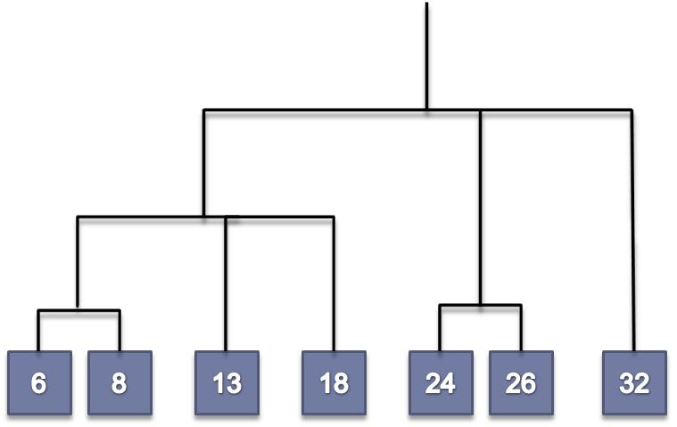
Compare dendograms
single-link
complete-link
Tianhua Chen(T.Chen@hud.ac.uk)::CHA2555 Artificial Intelligence::Lecture 21::Clustering 2
Notes:
Which is better?

Slide 47
HAC critique
What do you think are the advantages of HAC over k-means?
  k not required at the start
  A hierarchy is obtained (which can be quite informative)
  Many possible clusterings can be derived
  ...
What are the disadvantages?
  Where to slice the dendogram? (cluster validity measure might help here though)
  Which choice of linkage?
  Flat clustering is usually more efficient run-time wise while hierarchical clustering can be slow
Tianhua Chen(T.Chen@hud.ac.uk)::CHA2555 Artificial Intelligence::Lecture 21::Clustering 2
Notes:
We still need to choose a suitable distance measure – the same problem as for k-means. If the features are not real-valued (e.g. have labels rather than numbers), then distance is difficult to define, and taking the mean is meaningless (e.g. what’s the average of “The A Team”, “Game of Thrones” and “Homeland”?)

Slide 48
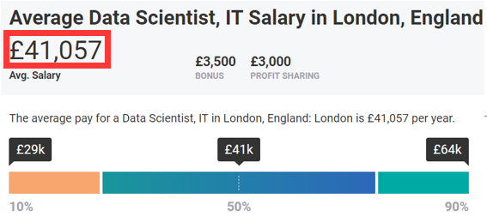

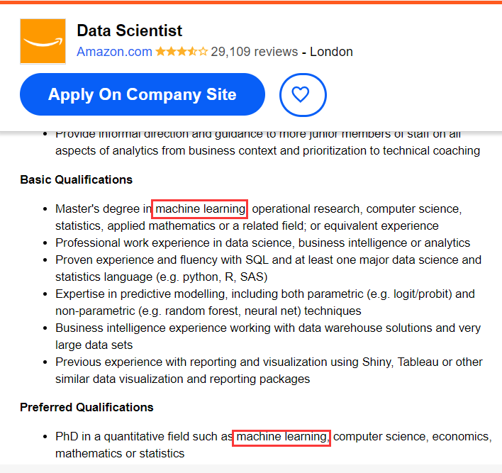
ML Skills for Job Market
Tianhua Chen(T.Chen@hud.ac.uk)::CHA2555 Artificial Intelligence::Lecture 21::Clustering 2

Slide 49

2018 Turing Award Winners
Tianhua Chen(T.Chen@hud.ac.uk)::CHA2555 Artificial Intelligence::Lecture 21::Clustering 2

